Slide 1
Mediterranean food
Toni Ortiz González
Jordi Quirós Berbel

Slide 2
What is Mediterranean food?
Mediterranean diet is known as feeding mode based on an idealization of some dietary patterns of the Mediterranean countries.

Slide 3
Features
High consumption of plant products.
Olive oil as main fat.
Regular consumption of wine in moderate amounts.

Slide 4
Why is good Mediterranean food?
The fat of oil of olive.
The blue fish have Omega-3.
The wine have cardiovascular protection.

Slide 5
When we eat?
Breakfast
A little lunch
Lunch
A snack
Dinner

Slide 6
Who are the most important chefs in Catalonia?
Ferran Adrià
- El Bulli
Carles Gaig
    Can Gaig
Miquel Sánchez Romera
    (Unfinished)
Jordi Parramon
    Jordi Parramon

Slide 7
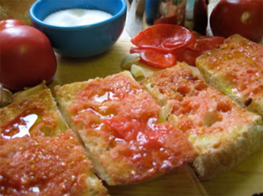
Catalonia food
Bread with tomatoes and oil

Slide 8
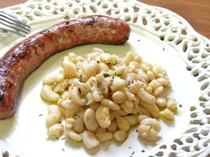
Catalonia food
Sausage with beans

Slide 9
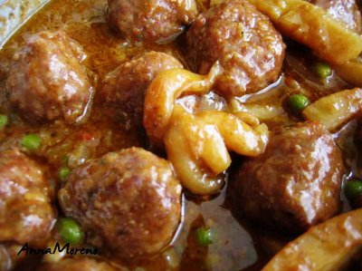
Catalonia food
Meatballs with cuttlefish

Slide 10
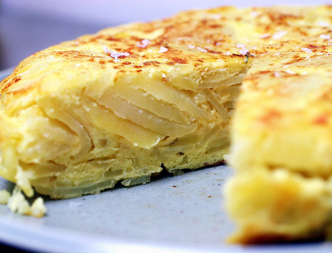
Catalonia food
Tortilla of potatoes

Slide 11
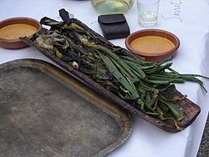
Catalonia food
Calçots

Slide 12
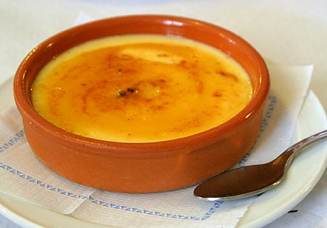
Catalonia food
Catalan Cream

